Slide 1
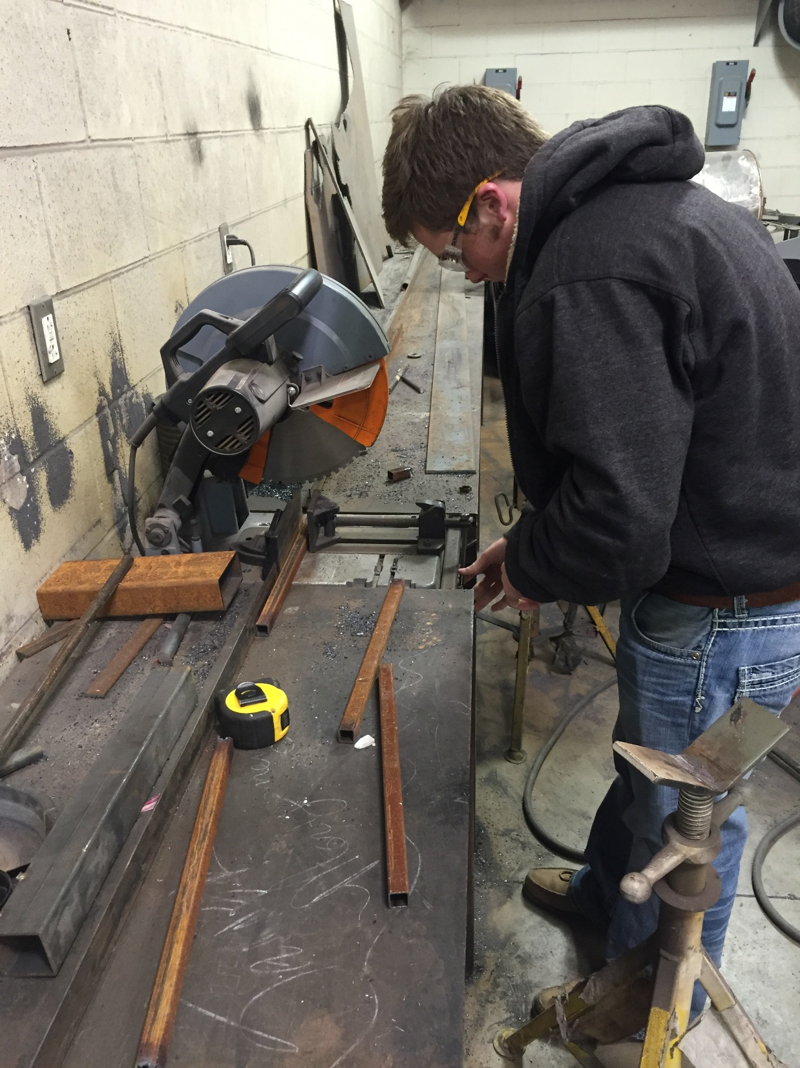
Preparing the saw before cutting.

Slide 2
Cutting 1”x1” Square Tubing used for legs.

Slide 3
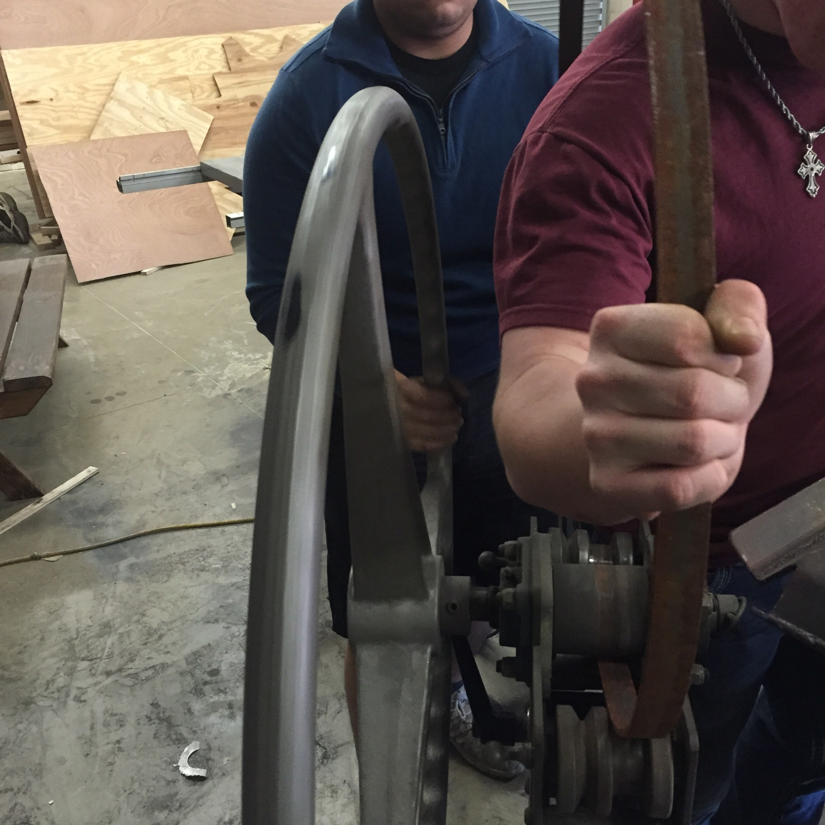
Using the Ring and Arc Roller to shape flat strap used to hold wood.

Slide 4
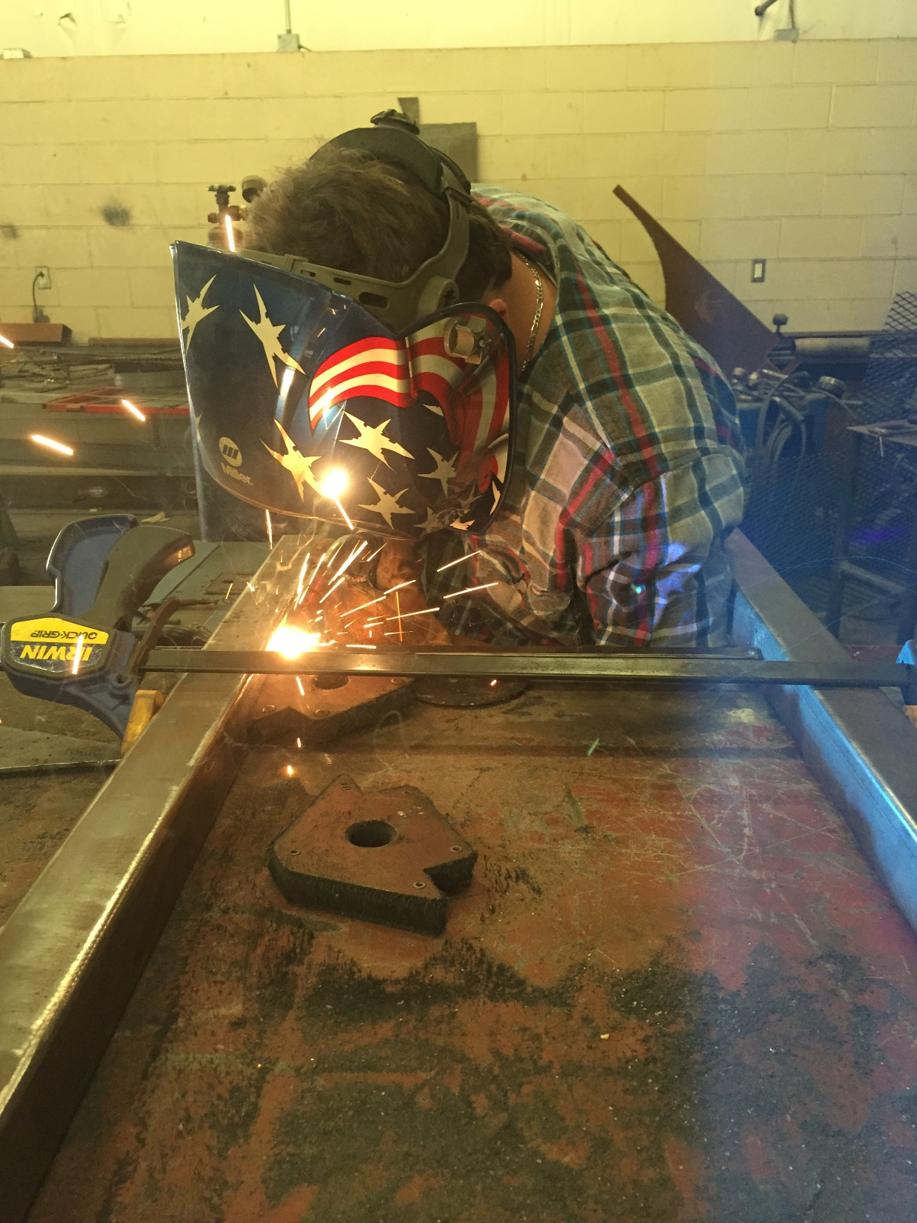
Using the MIG Welder to tack items in place before welding.

Slide 5
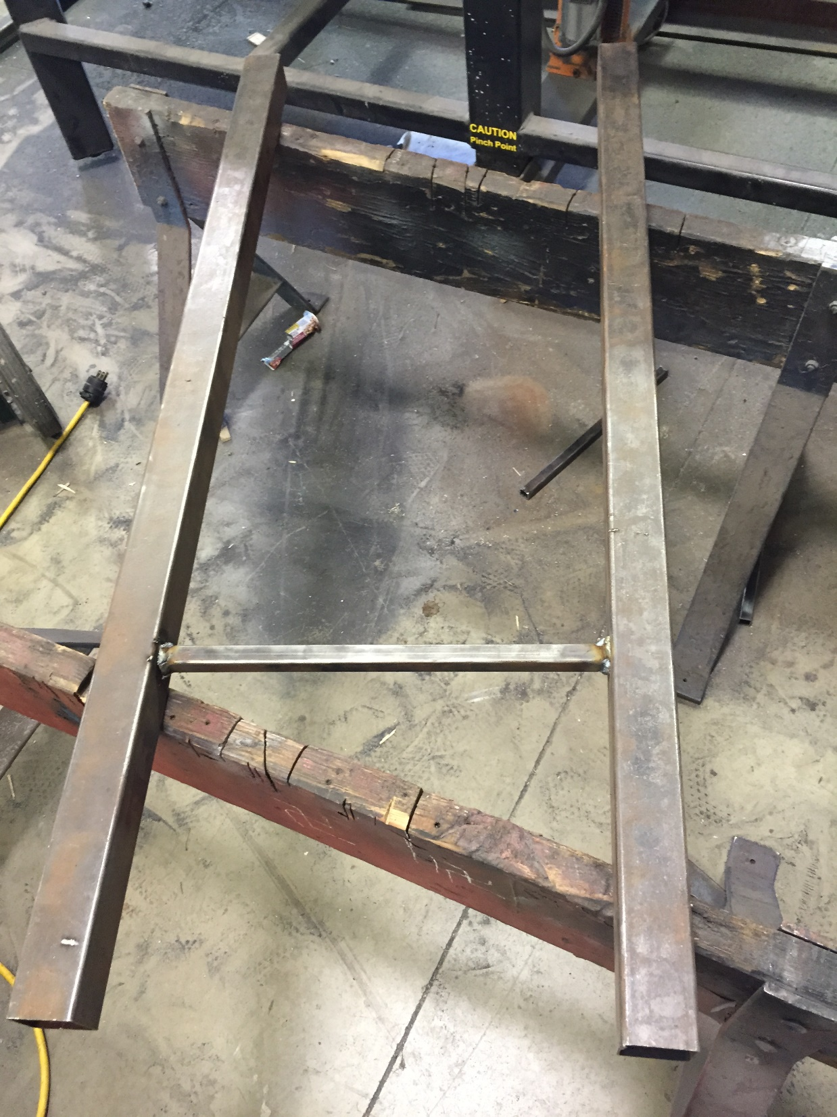
It is important to continually check items for imperfections so they can be corrected before continuing.

Slide 6
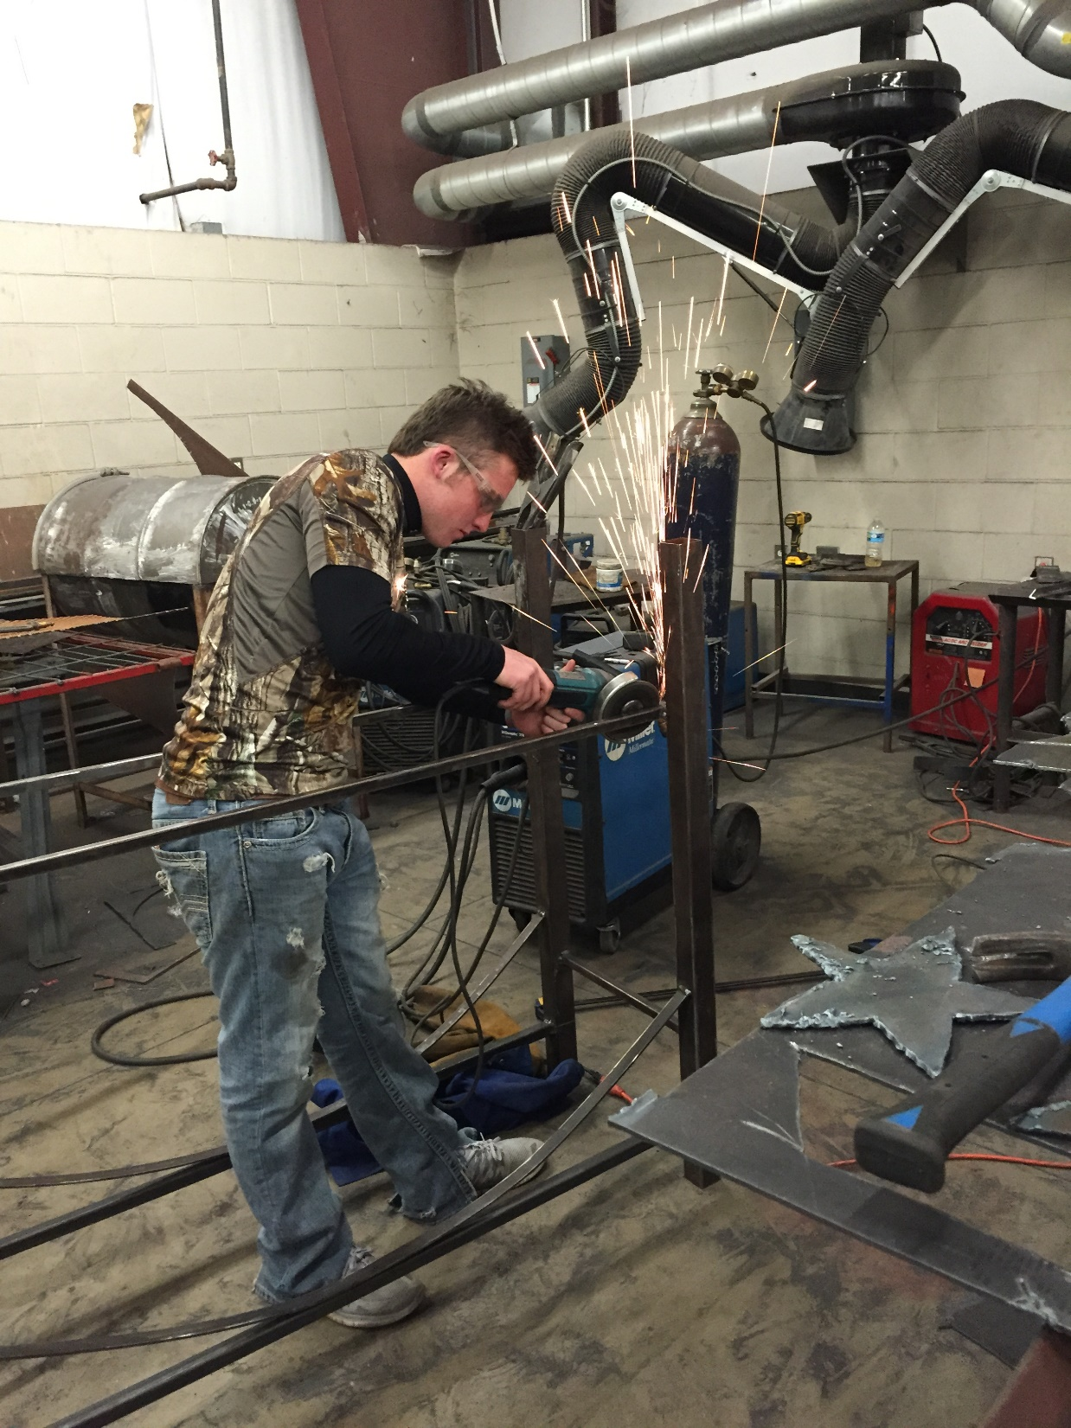
Using the Angle Grinder to grind areas smooth before welding.

Slide 7
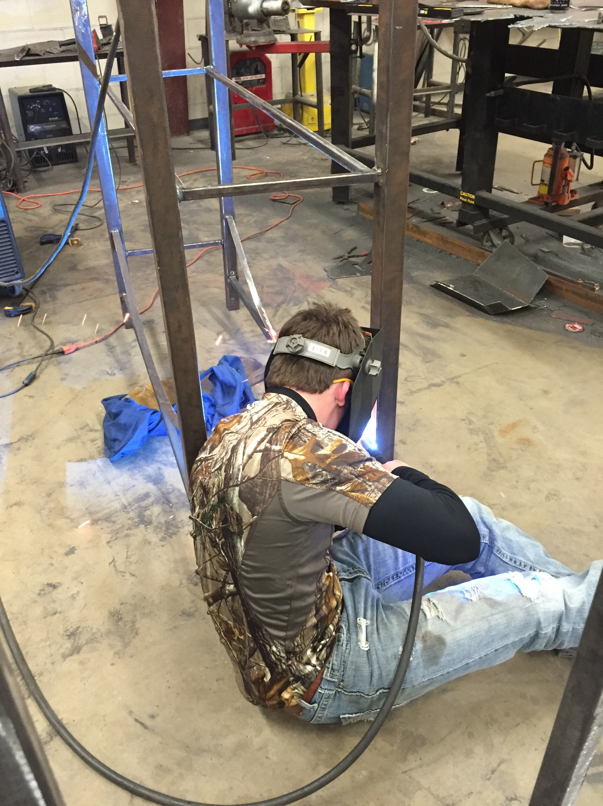
Using the MIG Welder to weld the bottom braces in place.

Slide 8
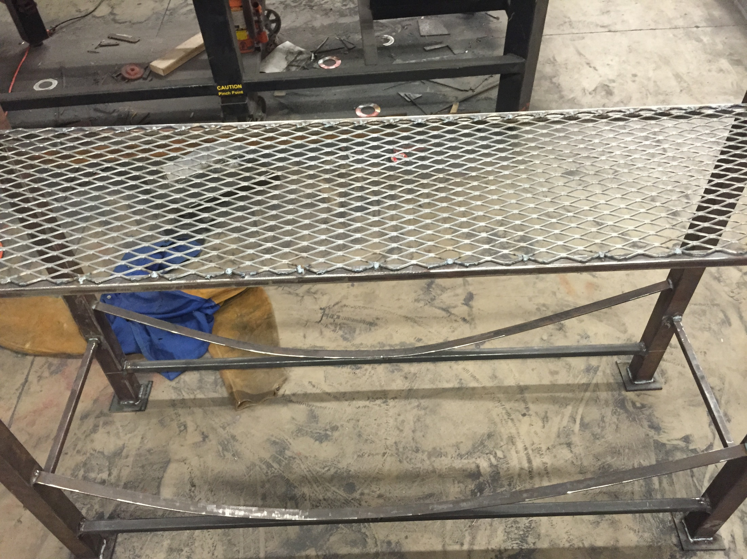
Fabrication is complete. Here is a look at the project before paint.

